Slide 1
THE ROAD
Another Lifestyle? SLOW DOWN to Explore More Beauty.
MEDIART 206 Midterm Project
By Roxanne Bei

Slide 2
For the uncertainties in LIFE…
We can’t determine WHAT we will meet,
But we can decide HOW to meet them.
Attitudes, lifestyle, etc.

Slide 3
The project proposes my ideal attitudes and lifestyle ;)

Slide 4
SLOW DOWN
Try another lifestyle to Explore MORE Beauty
How do you want to view this world?

Slide 5
In life | In this project
Things we meet (WHAT we meet) | Cones in the road
Our attitudes and lifestyle (HOW we face them) | Moving speed and scope
What our life is like when having the above attitudes/choosing the above lifestyle | The scene in the sky and the style of the cones
The scope of your view in life | The area that can be clearly seen

Slide 6
The more you slow down,
the MORE beauty you will see and
the BETTER understandings you will have for the things you meet.

Slide 7
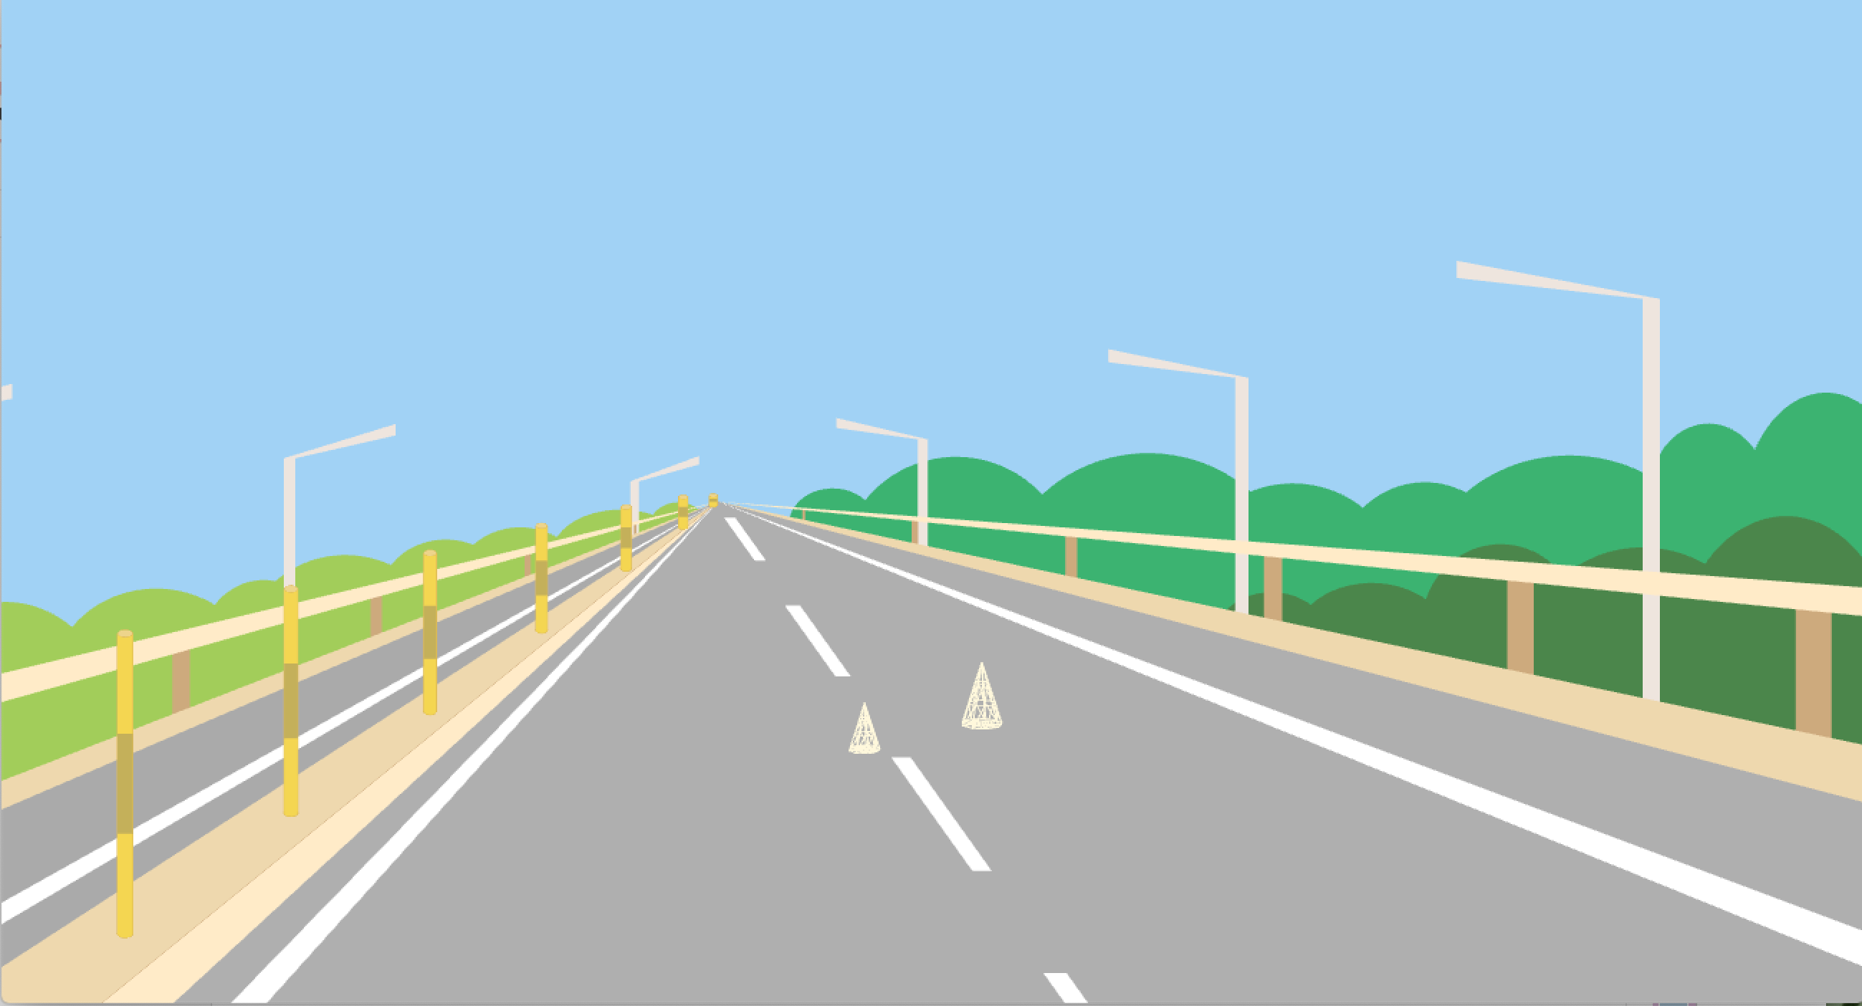
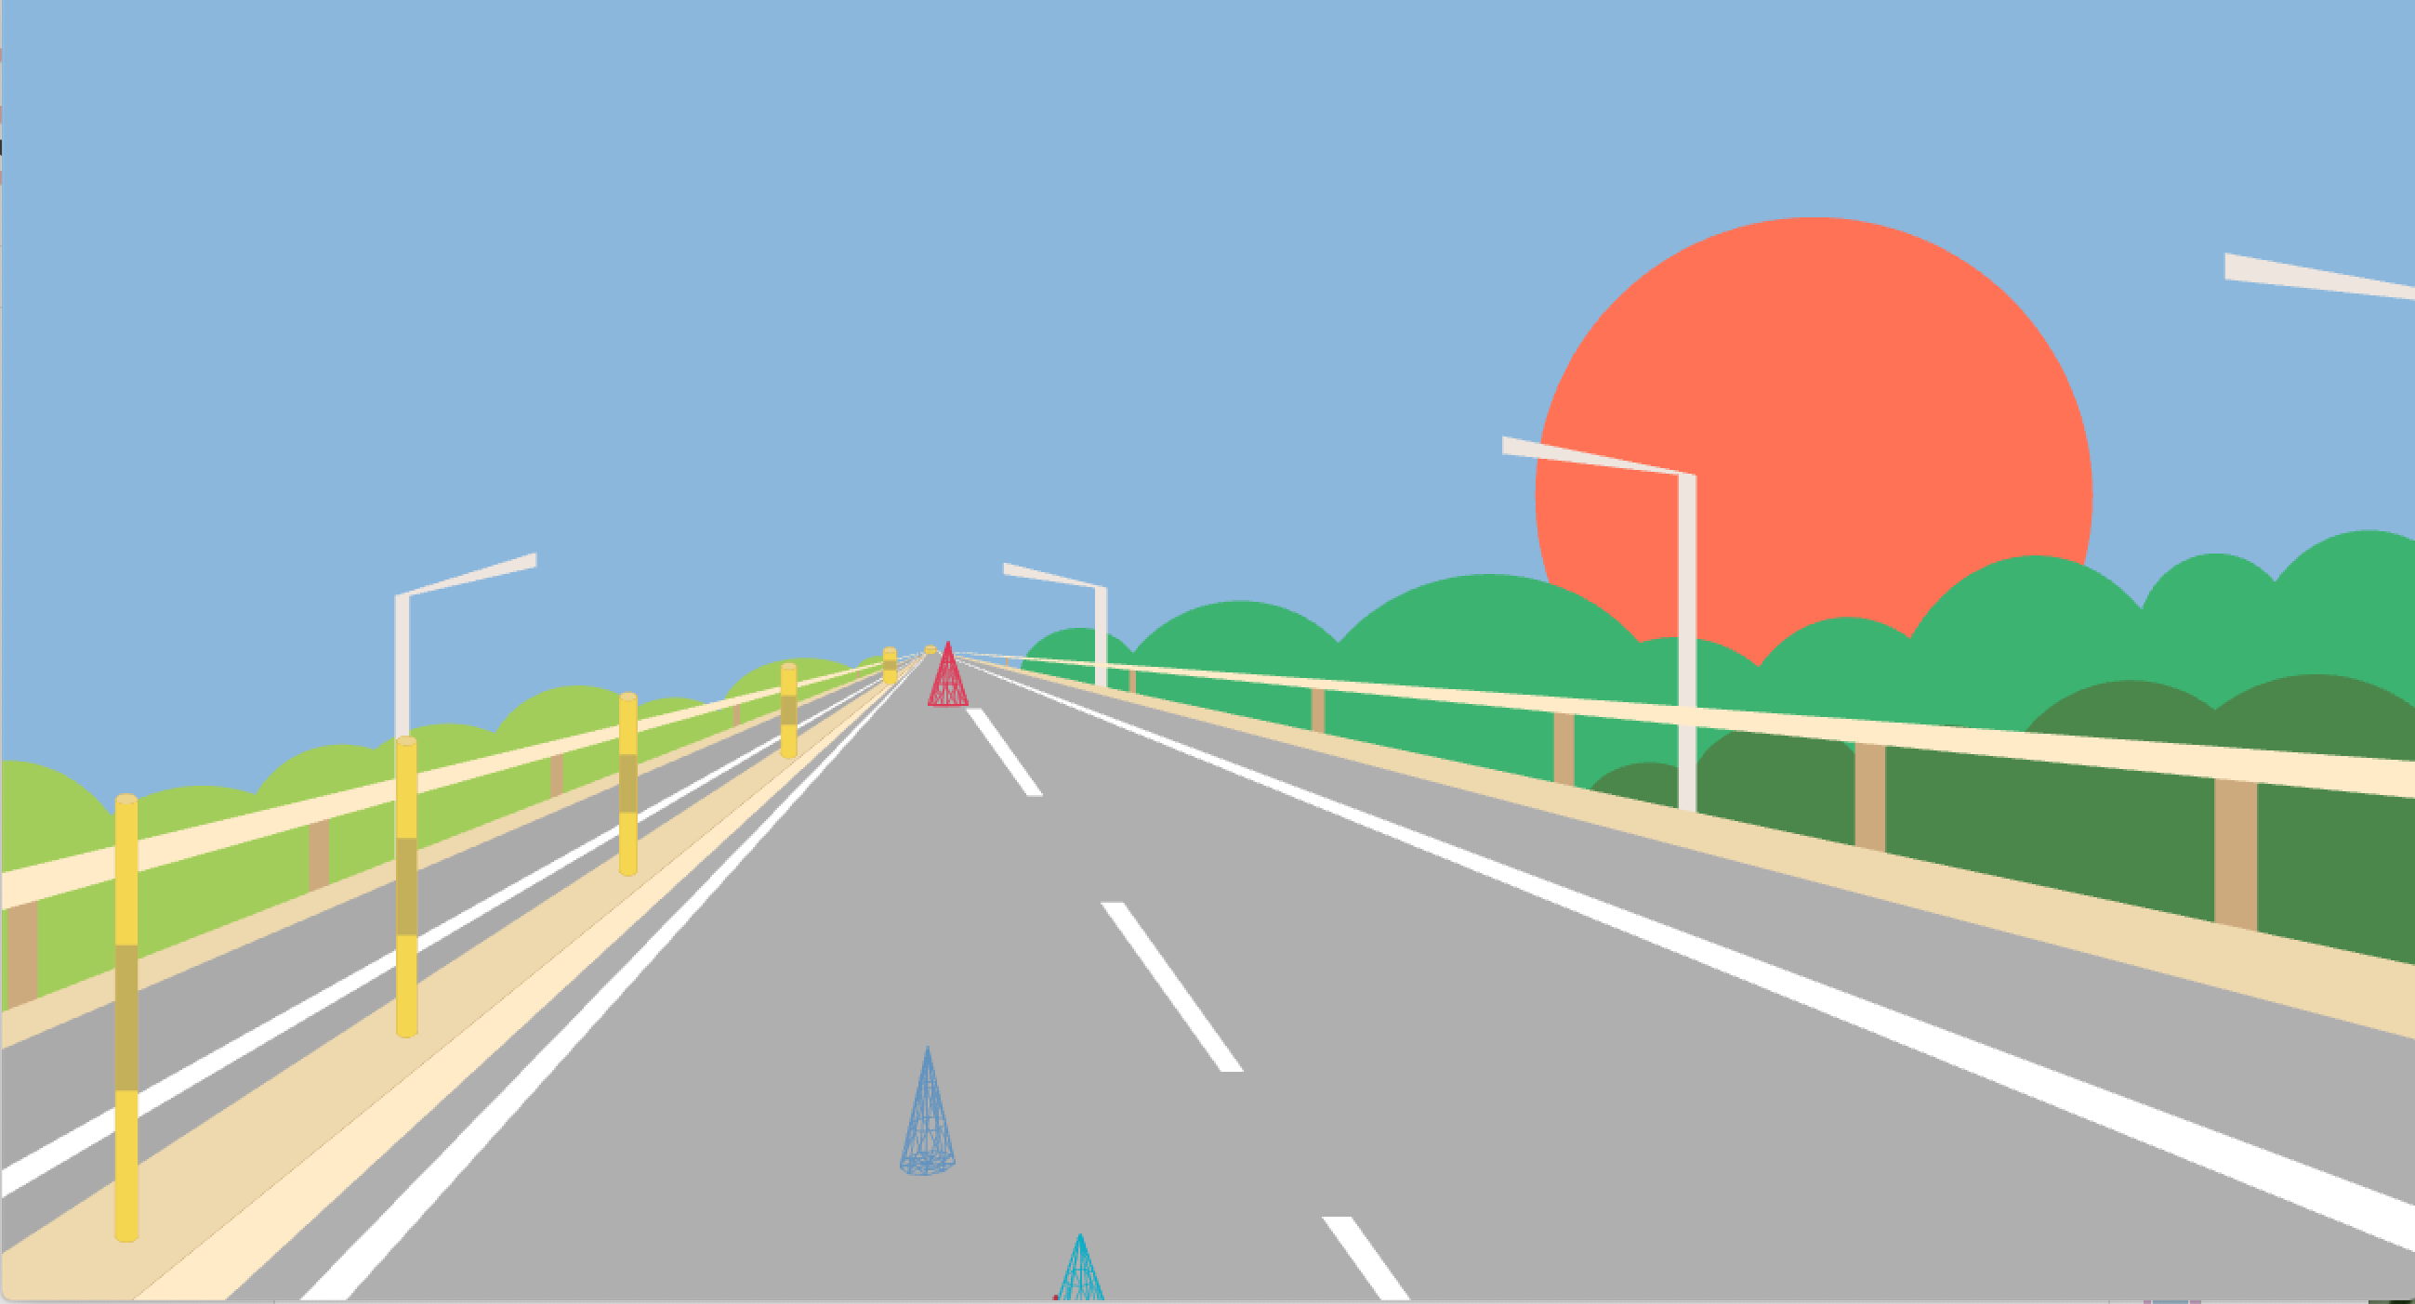
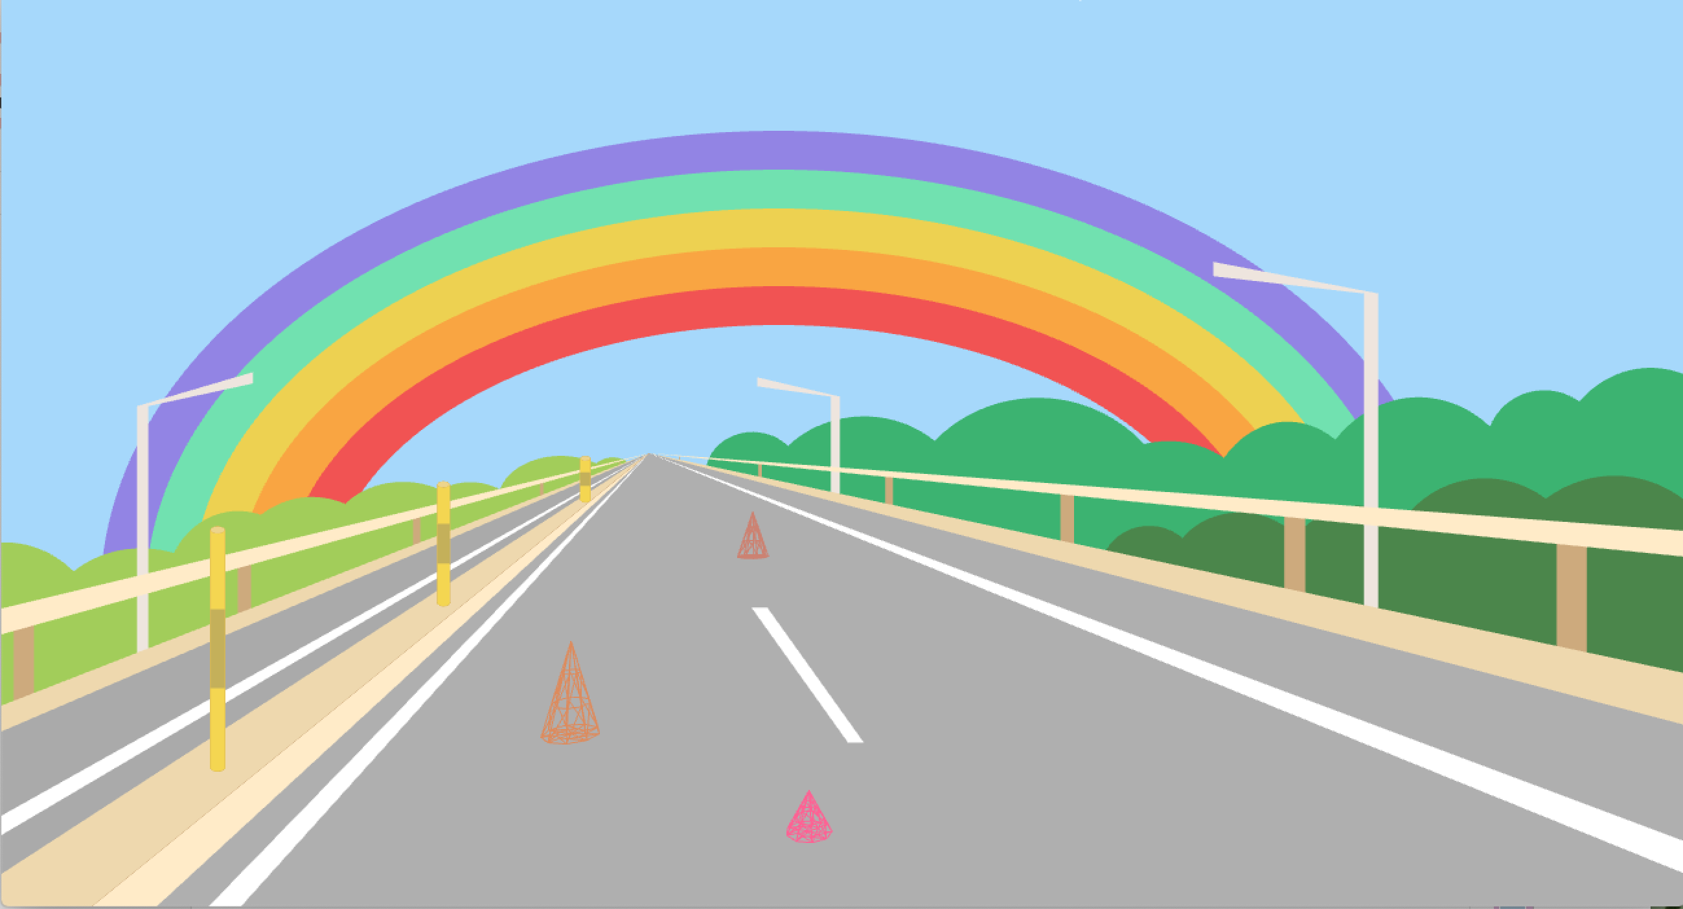
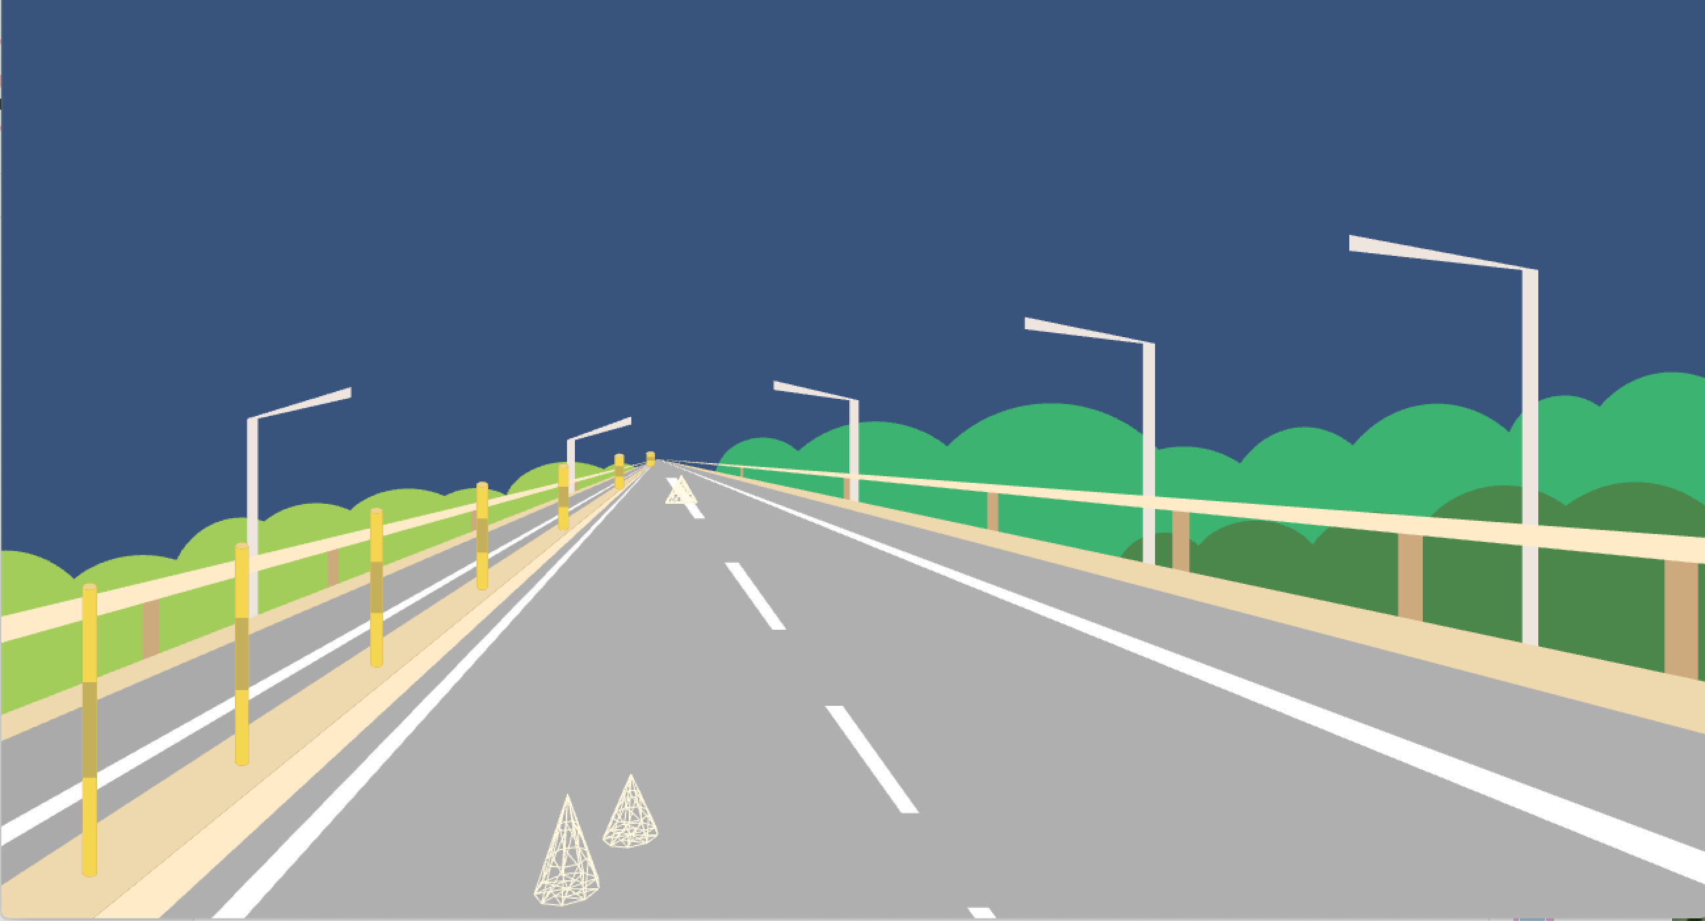
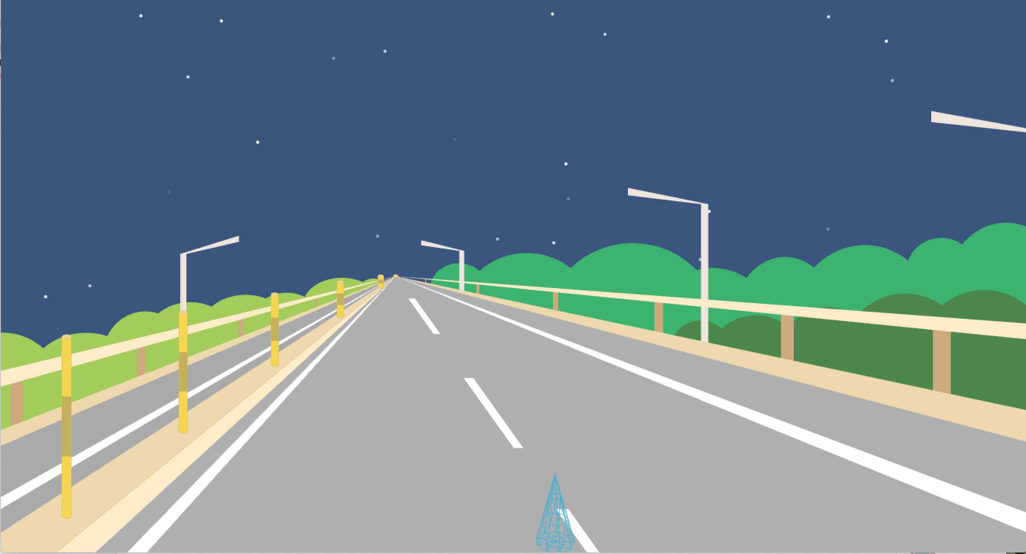
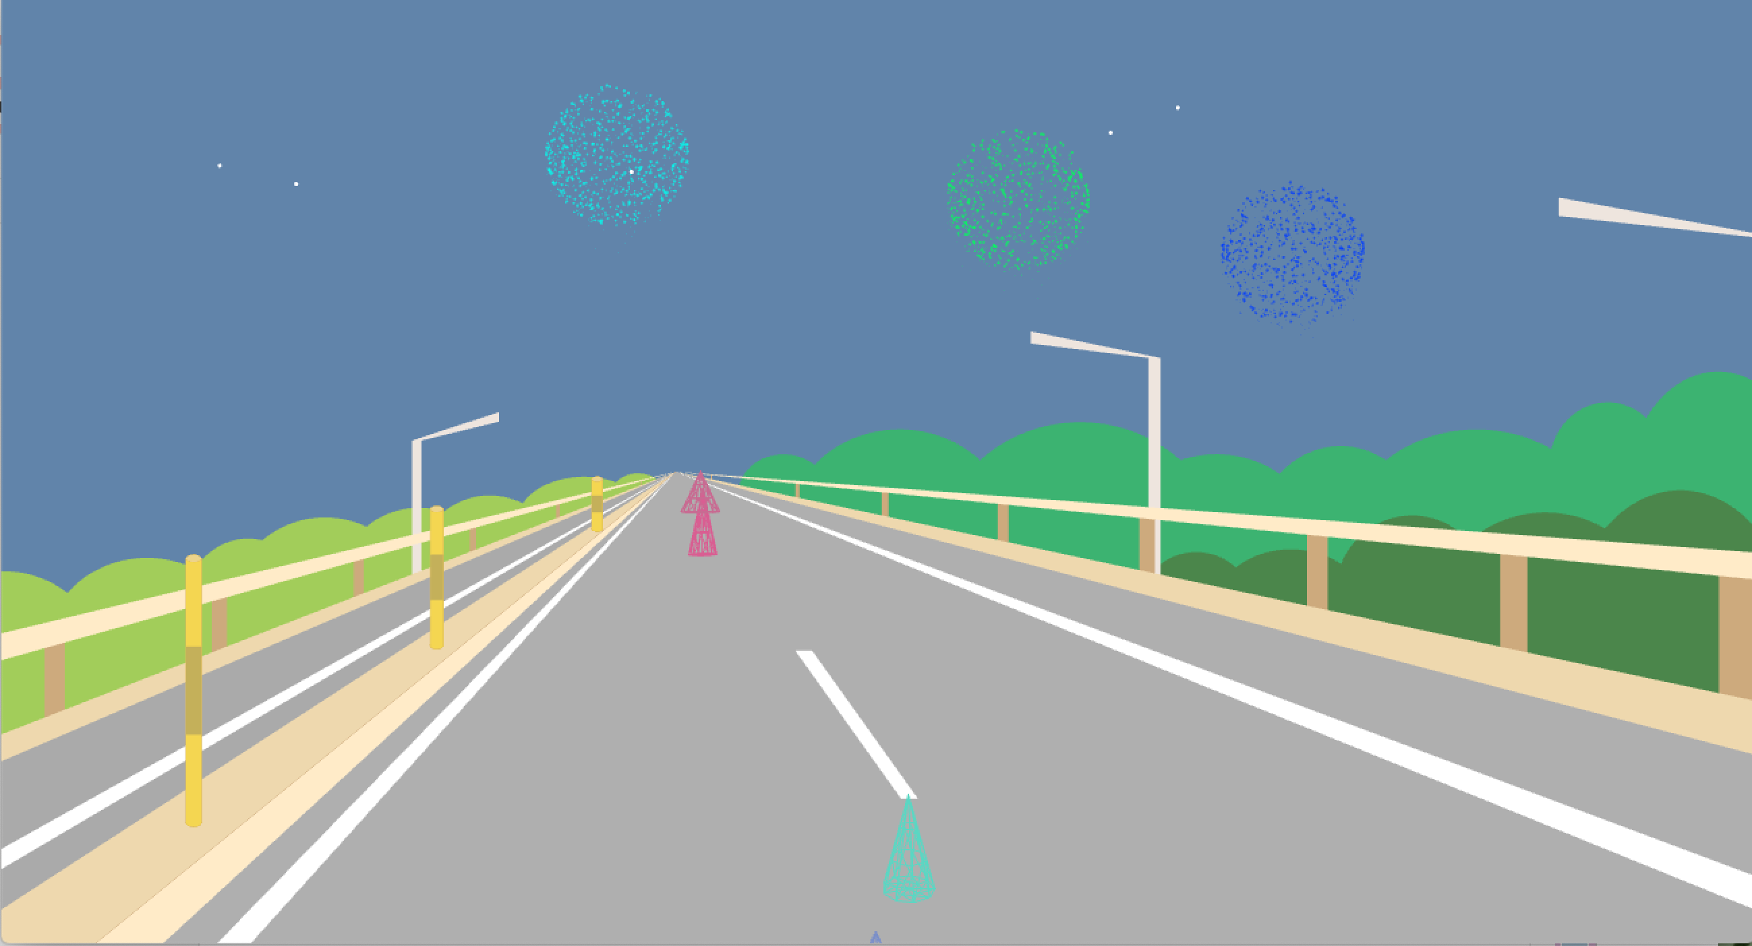
Speed | Day & Night | Sun & Stars | Meteors, Rainbow & Fireworks
Slow | √ | √ | √
Median | √ | √
Fast | √

Slide 8
LIVE DEMO

Slide 9
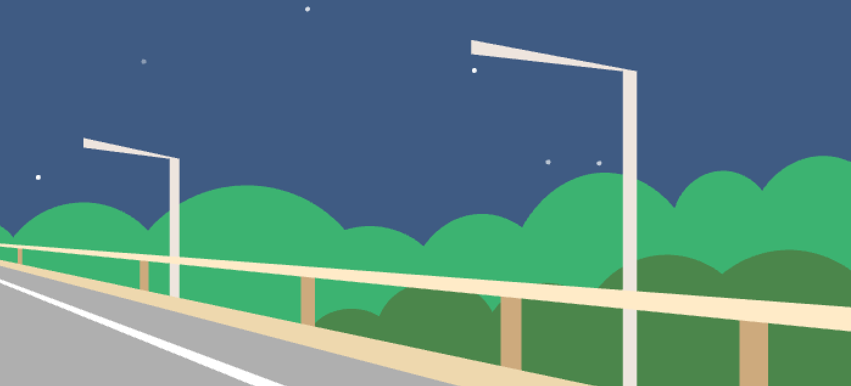
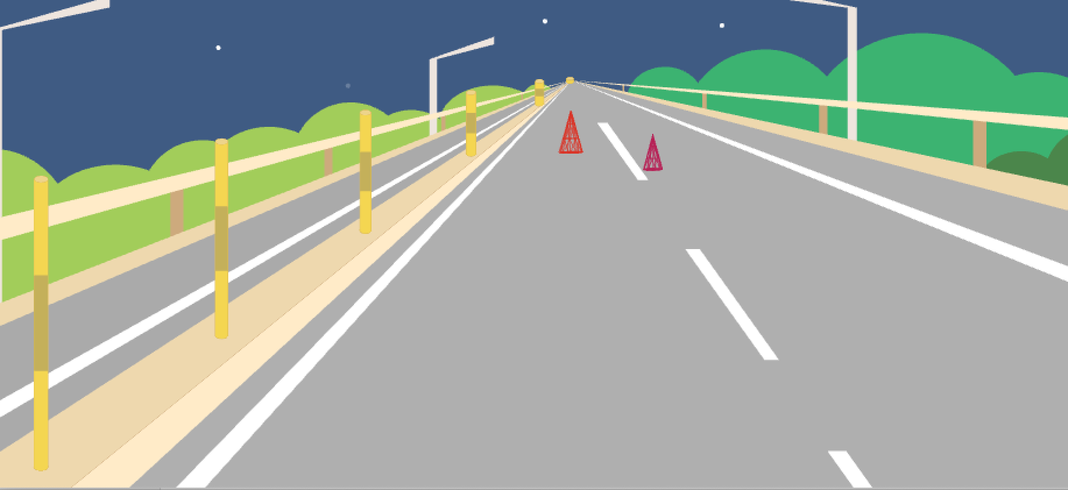
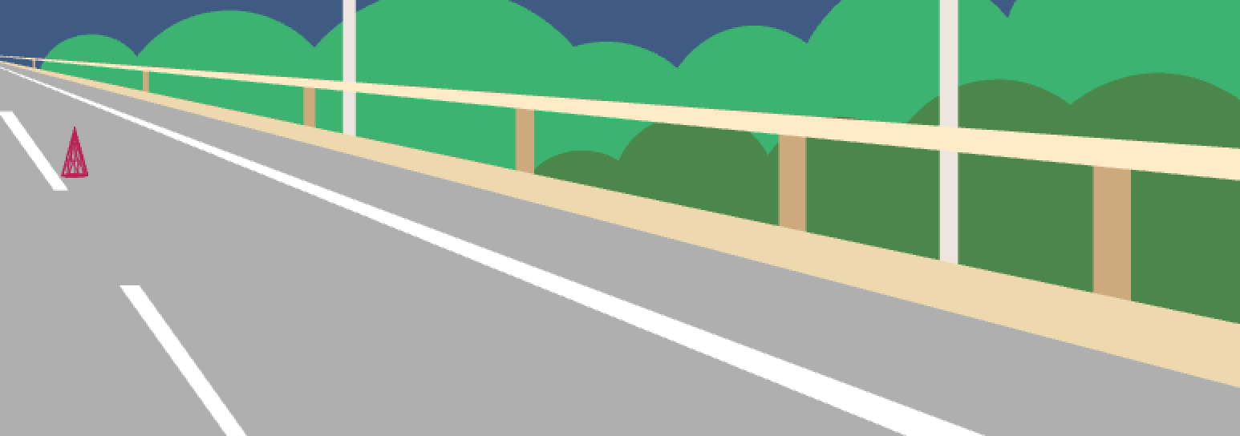
Property | Class Name/Implementation Method | Function & Effect
Periodic new an object and push back to the vector in each periodic | Light.hpp & Light.cpp (3D) | Lights on the roadside
 | Road.hpp & Road.cpp | The zebra-crossing-line & The fence between two roads
 | SideRoad.hpp & Sideroad.cpp | The roadside fence

Slide 10

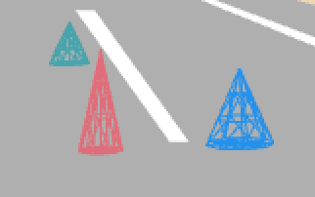
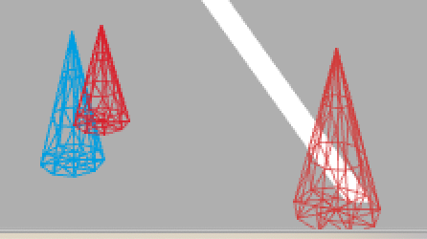
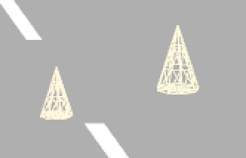
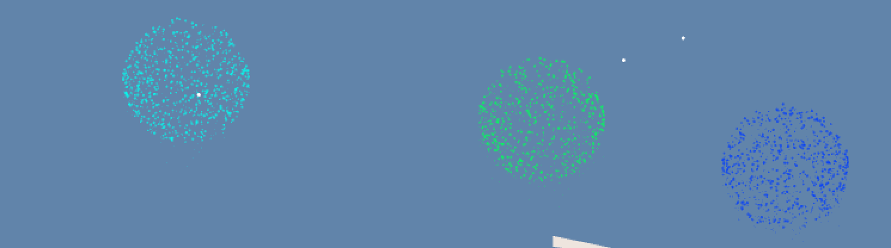
Property | Class Name/Implementation Method | Function & Effect
Random appear randomly | Field.hpp & Field.cpp Meteor.hpp & Meteor.cpp | Meteors
 | Events.hpp & Events.cpp (3D) | Cones
 | Particle.hpp & Particle.cpp ParticelSystem.hpp & ParticleSystem.cpp | Fireworks

Slide 11
Thank You
THE RODE: SLOW DOWN to Explore More Beauty.
MEDIART 206 Midterm Project
By Roxanne Bei

